Slide 1
Argus
Realistic Target Coverage with Drones
Ahmed Saeed, Ahmed Abdelkader, Mouhyemen Khan, Azin Neishaboori, Khaled Harras, and Amr Mohamed

Slide 2

Target Coverage Problem
Given the location of a set of targets, find the best camera configuration to cover them
Assumes known target information and camera parameters

Slide 3
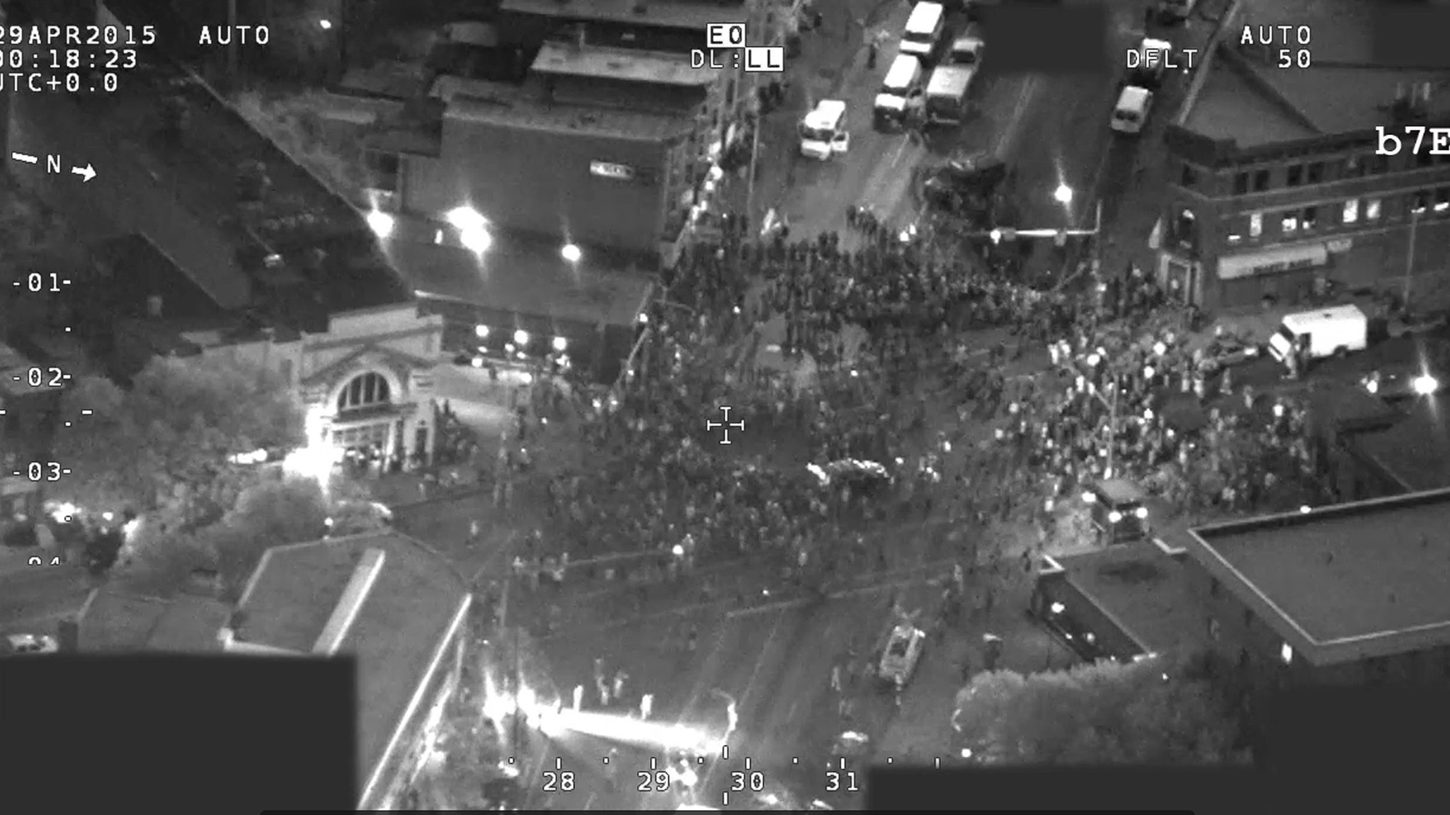
Sources of Target Information
Applications: surveillance, cinematography, and infrastructure inspection
Coarse grain coverage Fixed target configuration

Slide 4
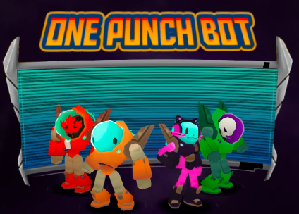
Constraints for Target Coverage
Camera Field of View Rmin, AOV, and Rmax
Target Size A target is covered only if all of it is in the camera’s view
Viewing Direction Target and camera facing each other
Occlusions Mutual occlusion between targets and occlusion because of obstacles

Slide 5
Status of Target Coverage Algorithms
Targets typically represented as points overlooking target size, orientation and occluders
Sensor capabilities (e.g., coverage area, energy constraints, and connectivity)
Coverage of point targets using fixed PTZ cameras [INFOCOM’11,’12]
Heuristics for coverage with mobile cameras [MASS’14 and MobiWac’14]
Quality of coverage (e.g., location of targets within camera field of view)
High quality coverage of targets using fixed PTZ cameras [INFOCOM’14]

Slide 6
But targets are more than blips on the radar …

Slide 7
Outline
A Realistic Target Model
Argus System Architecture
New Algorithms for a New Model
Experimenting with Argus
Conclusion

Slide 8
Realistic Target Model
Oriented Line Segment Model
Targets have width, orientation, and location
Targets parameters can be captured by line segments
Line segment length represents width
Vector perpendicular to line segments represents orientation

Slide 9
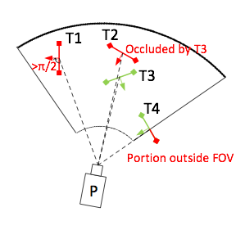
Coverage Model
A target is covered if
Facing the camera
Not occluded by other objects
Fully contained in the field of view of the camera (avoid stitching)

Slide 10
Outline
A Realistic Target Model
Argus System Architecture
New Algorithms for a New Model
Experimenting with Argus
Conclusion

Slide 11
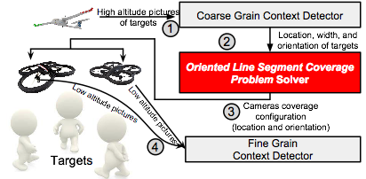
Argus
Two-tier surveillance system
Top tier: coarse grain surveillance
Count, location, and width
Bottom tier: fine grain information
Facial and activity recognition

Slide 12
Argus
Oriented Line Segment Coverage (OLSC) Solver
Finds cameras location and orientation to cover all targets
Minimizes the number of cameras needed to cover all targets
Problem is NP-Hard and APX-Hard
O(log N) approximation is best possible

Slide 13
OLSC Solver
Approach: reduce OLSC to a set cover instance
Finds the best configuration of drones to cover targets
Spatial Discretizer
Angular Discretizer
Configuration Selector

Slide 14
OLSC Solver
Approach: reduce OLSC to a set cover instance
Finds the best configuration of drones to cover targets
Spatial Discretizer
Angular Discretizer
Configuration Selector

Slide 15
OLSC Solver
Approach: reduce OLSC to a set cover instance
Finds the best configuration of drones to cover targets
Spatial Discretizer
Angular Discretizer
Configuration Selector
x
x
x

Slide 16
OLSC Solver
Approach: reduce OLSC to a set cover instance
Finds the best configuration of drones to cover targets
Spatial Discretizer
Angular Discretizer
Configuration Selector
x
x
x
x

Slide 17
Outline
A Realistic Target Model
Argus System Architecture
New Algorithms for a New Model
Experimenting with Argus
Conclusion

Slide 18
Spatial Discretizer
Converts the infinite search space into a few representatives
Selects representatives that can represent any optimal configuration
Comprehensive representation necessary for approximation algorithm

Slide 19
How to Cover a Single Target?
Rmax
Target has to be within range of the camera

Slide 20
How to Cover a Single Target?
Rmax
Target has to be facing the camera

Slide 21
How to Cover a Single Target?
Target has to be fully contained the cameras view

Slide 22
How to Cover a Single Target?
Camera should be facing the target within a certain viewing angle for quality of view

Slide 23
How to Cover a Single Target?
We call this shape the Basic Camera Placement Field (BCPF)

Slide 24
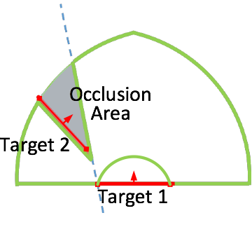
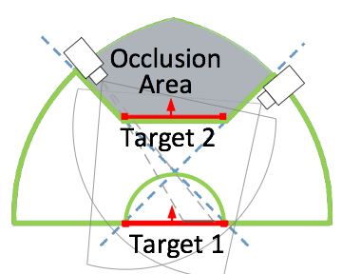
How to Cover a Single Target?
Exclude occlusion areas from BCPF
Excluding more areas based on any arbitrary constraints does not affect the rest of our approach

Slide 25
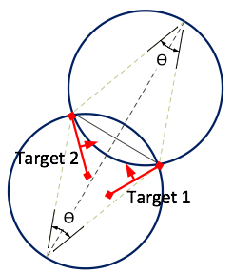
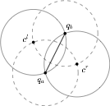
How to Cover a Pair of Target?
AOV circles
Two targets have to be within the angle of view (AOV) of the camera

Slide 26
Spatial Discretizer
Representatives generated by intersecting CPFs and AOV circles
Constraints enforced in pairwise fashion for N targets
Comprehensive representation is possible but requires O(N⁴)
Comprehensive representation allows for O(log N) approximation
Heuristic: sample the BCPF at a small fixed angle
Works surprisingly well and is only O(N)

Slide 27
Angular Discretizer
Selects viewing directions for each representative
Chosen angle can be adjusted to put targets at the center of the field of view or other objectives

Slide 28
Configuration Selector
Discretizers produce candidate camera configurations each covering a subset of targets
Camera configurations Sets
Targets
Minimize number of cameras to cover all targets
Greedy algorithm provides O(log N) approximation for OLSC
Elements
Set Cover

Slide 29
Outline
A Realistic Target Model
Argus System Architecture
New Algorithms for a New Model
Experimenting with Argus
Conclusion

Slide 30
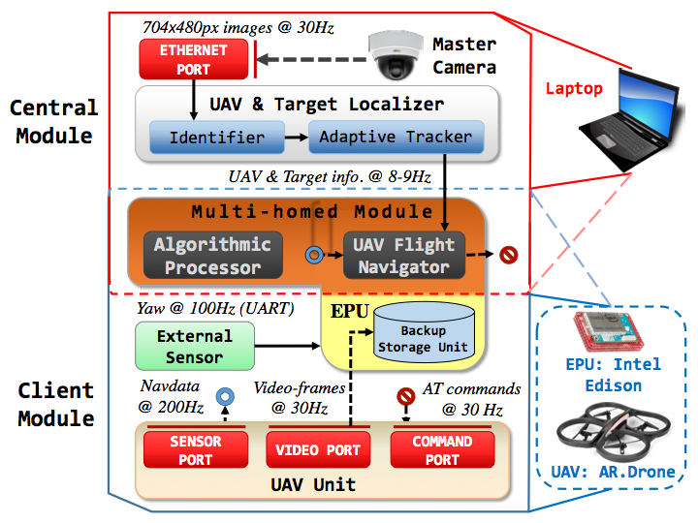
Argus Implementation
An autonomous system of drones
Central controller
Drone and target localization
Drone autonomous control
Drones process images locally
Sensors array and processor added to each drone to improve control and add computational capacity

Slide 31
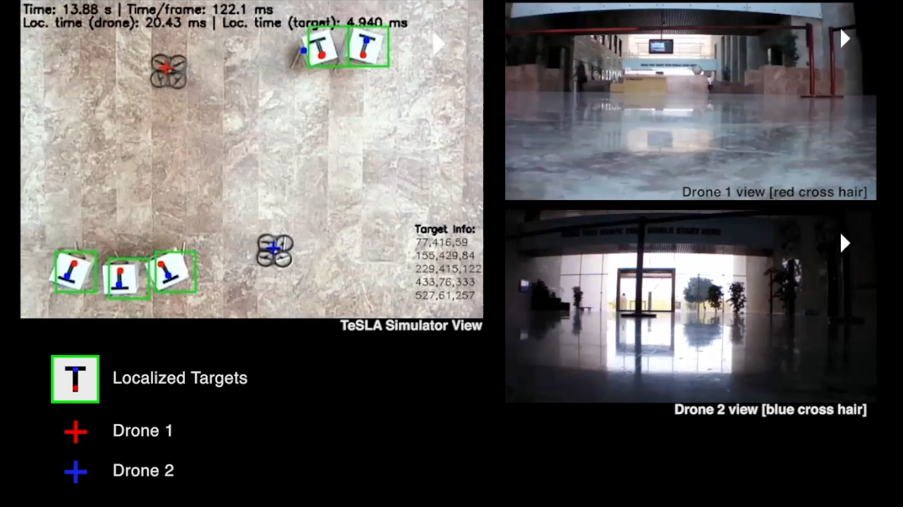

Demo
https://www.youtube.com/watch?v=KJbZWtGehPg

Slide 32
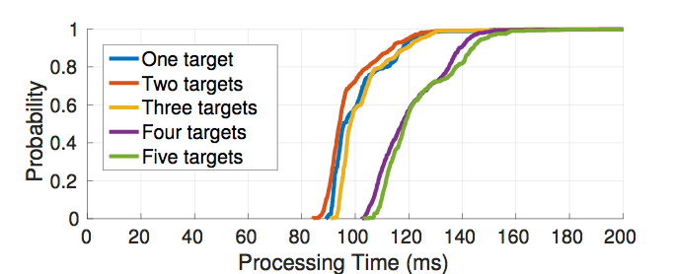
Overhead of OLSC Solver
One drone
Two drones
Processing time is dominated by the control overhead of two drones

Slide 33
Conclusion
We presented a more realistic target model that enables a new class of target coverage algorithms
The Oriented Line Segment model is flexible enough to allow different coverage constraints and desired quality objectives
Proposed heuristic is suitable for realtime application including surveillance and cinematography

Slide 34
Questions?
Ahmed Saeed: amsmti3@gatech.edu

